Slide 1
BANKING SOLUTIONS
1. INTRODUCTION
This software will be provided as a tool to the BANK. The BANK has been working for Accounts information, Withdrawal (through Cash/Cheque). Deposit amount. In this Software you can keep record for daily Banking transactions. THE OBJECTIVE is to prepare a software or application, which could maintain data & provide a user friendly interface for retrieving customer related details just in few seconds, with 100% accuracy.
Software is completely computerized, so it is not time
consuming process. No paper work required & can be
implemented further.
The application should also facilitate the addition of new Customer A/c, deletion of A/c& modification of existing customer A/C. To Search for every individual accounts for a particular customer, show all transaction & any account should be opened with minimum Rest. 500 etc.

Slide 2
1.1 OBJECTIVES AND GOALS
The objective & goals of the proposed system are:-
To allow only authorized user to access various functions and processed available in the system.
Locate any A/C wanted by the user.
Reduced clerical work as most of the work done by computer.
Provide greater speed & reduced time consumption.
To increase the number of A/C and customer.
This will reduced the manual workload and give information instantly. The software will maintain the list of A/C and customer record and balance status.
The software will be user friendly so that even a beginner can operate the package and thus maintain the status of A/C and balance status easily.
The Project Banking system has been made to automate the Banking system being followed by a banking company that deals in current account with or without check facility.

Slide 3
The User/ Manager can check A/C’s with a login & password & can
work out with A/C holders of the bank can withdraw/deposit
cash/ cheque /DD to/from their accounts. To enable faster
transactions like:-
New account creation.
Withdrawal of cash
Deposits of cash or cheque
Checking of Account balances by account holders by manager
Transaction records in the form of reports.
The project makes a sincere effort to provide all the above mentioned features to meet the requirements of the bank.

Slide 4
2. Overall Description
This section will give an overview of the whole system. The system will be explained in its context to show how the system interacts with other systems and introduce the basic functionality of it. It will also describe what type of stakeholders that will use the system and what functionality is available for each type. At last, the constraints and assumptions for the system will be presented.
Project Perspective
The System is an web portal. The web portal consists of two types of logins, one is called as Manager Login and other is called as official login.
The Chief of the bank accessing the portal through manager login will have all the rights and access privilege . Whereas the person who is accessing the web portal through official login has only limited access privilege as compared to manager.

Slide 5
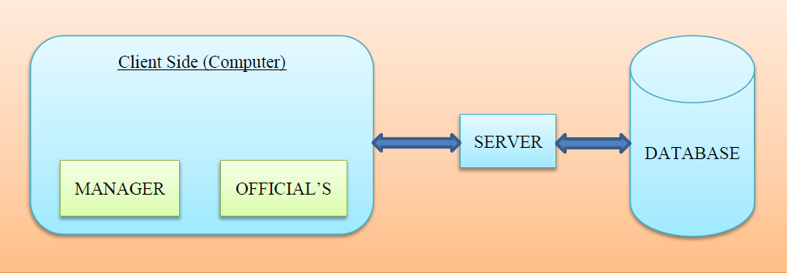
Abstract Model Of The System

Slide 6
Scope Of The Project
The first software project management activity is the determination of software scope. Scope is defined by answering the following question:
What customer visible data objects are produced as output from the software? What data objects are required for input?
What functions does the software perform to transform input data to output?
In this Project, HTML, Css, Bootstrap, Jquery and JavaScript are used for designing the front end and PHP and MYSQL are used for designing Back end.
Software scope is ambiguous and understandable at both the management and technical level.

Slide 7
Features
Powerful workflow module, which operates in conjunction with the accounting engine and is used as control centre
Searching accounts based on their types
Report generator
Open architecture
Interfacing with money transfer systems
Making up a complete hardware / software solution (a hosting solution)
Website construction including modern creative design
Risk Management
Securities Management
Accounts Handling

Slide 8
working
Bank
1
has
N
Branch
place
1
1
Work
1
name
having
gives
N
Staff
type
N
N
post
Account
Loan
a/c no
sid
1
Logs
M
Is_of
M
name
issues
No.of SB
M
d
N
N
Report & Stats
Customer
Saving
Current
name
phone
No.of CA
Balance
Addr
interest
Initial amt

Slide 9
User Class 1 - The Manager
Manager Login
DESC: In order to use the system Chief Manager Should be logged in to the portal.When the Manager logs in with his/her account.Then the manager should be logged in as a manager.
Addition of an employee
DESC: The Manager access the employee addition function in order to add the data of the employees into the bank database. Employees are granted permission to access the banking portal.
Removing an existing employee
DESC: If an employees leaves the bank or transferred to another bank branch, then his/her data can be removed from that particular bank database.
Adding a new customer.
DESC: For opening an customer account then his/her details for creation of new account can be added through adding new customer function.
Removing an existing customer account
DESC: If customer wants to close his/her account then the account can be closed by the account removal function.

Slide 10
Report and Statistics
DESC: Report and Statistics related to Total number of deposit accounts such as Fixed ,Recurring, Short-Term Deposits, etc. ,Total number of Loan accounts such as Over Draft, Home, Education, Car ,Gold ,Other accounts such as Total number of Public Provident Fund ,Demat, etc. Accounts can be viewed through report and statistics function.
Searching an existing record
DESC: Searching comes up with two types of searches.One is for searching existing customer and another is for searching existing employee record.

Slide 11
User Class 2 - The Officials
Official Login
DESC: In order to use the system Bank Officials Should be logged in to the portal. When the Staff logs in with his/her account. Then the Staff should be logged in with their respective name.
Opening an new customer account(SB/CA)
DESC: To open an new customer account, then customer details can be added through this function, thereby allows the bank to maintain the data consistently in the database.
Closing an existing customer account(SB/CA)
DESC: If customer wants to close his/her account then the account can be closed by the account removal function.
Updating an customer record
DESC:If the bank officials wishes to make any kind of changes to an existing record then it can be altered and updated through this function.
Searching an customer record
DESC: If the bank official wants to find an particular record from the database ,then using the Search function it can be done
Opening an deposit account
DESC: If customer wants to open an deposit account ,then it can be done through this function,this function also calculates the maturity amount by entering valid data.Thereby,reducing the tedious calculation procedure

Slide 12
TITLE: Opening an Fixed deposit account
DESC: If customer wants to open an Fixed deposit account ,then it can be done through this function,this function calculates the maturity amount for which valid amount, period and rate of interest should be entered.The amount should be greater than 1000 and period should be atleast for 1year
Opening an Recurring deposit account
DESC: To open an Recurring deposit account then there should be valid amount, period(more than 1 year) and rate of interest.
Opening an Short-term deposit account
DESC: To open an Short-term deposit account then there should be valid amount,period(less than or equal to 1 year) and rate of interest.
Opening an Loan account
DESC: To open an loan account then there should be valid amount, recovery period and rate of interest.It supports various types of loan account such as Overdraft,Home ,Education , Car ,Gold loan.Calculation of the amount is done automatically.User must ensure that valid data is provided.
Cash withdrawal
DESC: If customer wishes to withdraw amount from their account(SB/CA),then it can be facilitated through this function.Bank officials should ensure that withdrawal slip should contain necessary information such as account number,account name,type of account, amount to be withdrawn and account holder signature.

Slide 13
Cash Deposit
DESC: If customer wishes to deposit amount to their account(SB/CA/PPF) or deposit account(RD),then it can be facilitated through this function. Bank officials should ensure that deposit slip should contain necessary information such as account number, account name, type of account, amount to be deposited and depositor's signature.

Slide 14
Working Documentation
Every system requires periodic evaluation after implementation. Unlike system testing which determines where the system fails, the operation documentation review determines how well the system continues to meet performance specification. It also provides information as to determine whether major redesign is necessary. The operation documentation review provides the evaluation of a system in terms of the extent to which the system accomplishes stated objectives and actual project costs exceed initial estimates. The initiating study begins with the review team, which gathers and reviews request for evaluation. It also files discrepancies notices after the system has been accepted. Unexpected changes in the system that affects the user or system performance is a primary factor that prompts system review. Once a request is filed, the user is asked how well the system is functioning to specification. Suggestion is sought and this marks the beginning of the operation documentation review.

Slide 15
Requirement Plans
Administrative plan:
The review group probes the effect of the operational system on the administration procedures of the user. The following activities are carried out:
1. User objectives
2. Operating cost and benefits.
Personal requirement plan:
This plan evaluates all the activities involving system personnel and staff as they directly deal with the system. The emphasis is on productivity, morale and job satisfaction
Hardware plan
The hardware of the new system is also reviewed, including terminals, CRT screens, software programs and the communication network. The primary target is a comparison of current performance specification with design specification. The outcome of the evaluation indicates any differences between expectation and realized results.

Slide 16
Conclusion
This banking system project will serve as a useful approach to data base dialog box to deposit and withdraw the money for the person. It serves as a helpful approach for the users. It provides easy way of the deposit and withdraws the money. It reduces the time taken by the user to save the money.
Thus the project is the user friendly approach.

